Slide 1
Deep Learning: Malaria Detection
Capstone Project Presentation
Naz Altekin

Slide 2
Key Takeaways/ Executive Summary
Overview of the Problem:
Malaria is a serious global health threat, and early detection is key. Manual diagnosis is slow and error-prone.
Goal: Develop a computer vision model to classify red blood cell images as either Parasitized or Uninfected.
Approach for the Solution
Binary image classification
CNNs used on labeled microscopic images
The focus is on recall—to minimize false negatives that could delay treatment
Key Findings & Insights
The best-performing model, CNN Model – Iteration 1 with Augmented images, achieved:
  99% recall, precision, and F1-score on both classes
  Only 28 misclassifications out of 2,599 test samples
Detection challenges: Subtle visual differences between classes: Varying cell shapes, lighting, and image noise
Conclusion: The model is highly suitable for medical imaging, where sensitivity is critical

Slide 3
Content
Problem Statement
Data Description
Data Preprocessing
Model Results
  ANN Model
  CNN Base Model
  CNN Model - Iteration 1
  CNN Model - Iteration 2
  Data augmentation
  Pretrained Model
Overall Comparison/Key Takeaways
Recommendations and Next steps

Slide 4
Problem Statement and Solution
Malaria is a life-threatening disease where traditional diagnosis involves manual inspection.
This is time-consuming, labor-intensive, and prone to human error.
A computer vision model using deep learning techniques for malaria detection can:
  Enhance early diagnosis
  Improve treatment outcomes
  Reduce mortality — especially in regions with limited access to skilled healthcare professionals.
A binary image classification problem is proposed where:
  Input: An RGB image of a red blood cell
  Output: A class label — either Parasitized or Uninfected

Slide 5
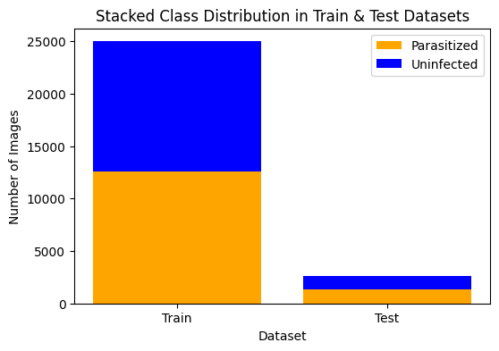
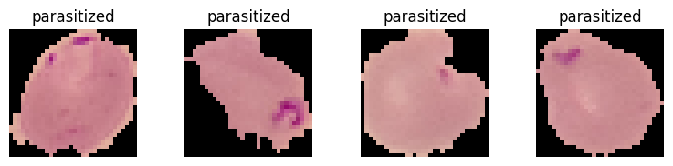
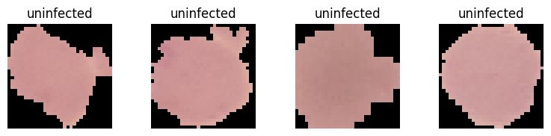
Data Description
Images are used to train and evaluate the models.
Datasets with 4D shape: each image having a size of 32x32 pixels (provide sufficient detail vs computational cost) and 3 color channels (RGB).
˜24.9k images are used for training. (well balanced with parasitized and uninfected cell images)
˜2.6k images are used to evaluate the models.
Sample Images

Slide 6
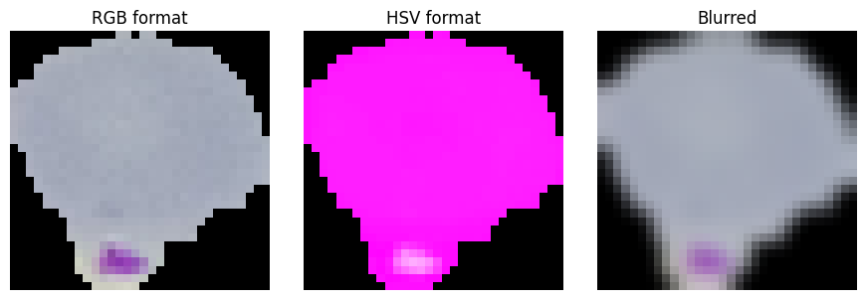
Data Preprocessing
RGB
HSV
Blurred
Normalization [0,255] to [0,1]
Input Type | Pro | Con
RGB Images | Easy to implement Preserves all original visual details Compatible with pre-trained models | Might include noise or irrelevant color variations. May not highlight subtle patterns
HSV Images | Can make some patterns easier to detect | May confuse pre-trained models expecting RGB input. Requires conversion step (adds complexity)
Mean Subtraction | Normalizes input, improving model training stability Helps CNNs converge faster and generalize better Reduces lighting bias | Needs preprocessing and potentially global dataset stats
Blurred images | Reduces high-frequency noise, helping the model focus on larger patterns Can help generalize better when textures are irrelevant | Risk of removing important fine details. May reduce overall accuracy if small patterns are critical (e.g., early-stage sickness signs)

Slide 7
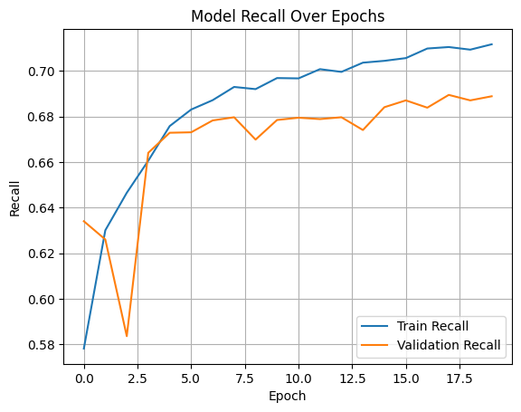
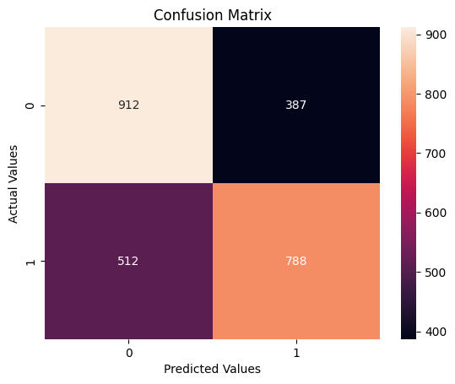
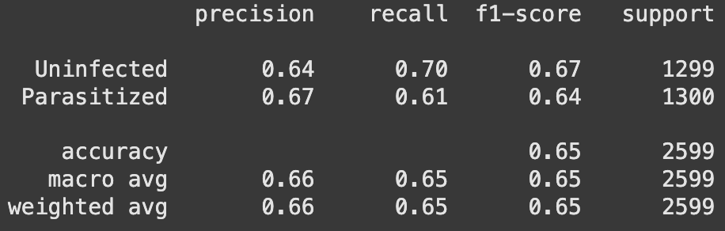
ANN Model Results
❌Overfitting
❌False negatives: 512
❌Recall: 65%
Model Recall over Epochs
Confusion Matrix
912
387
Metrics
512
788

Slide 8
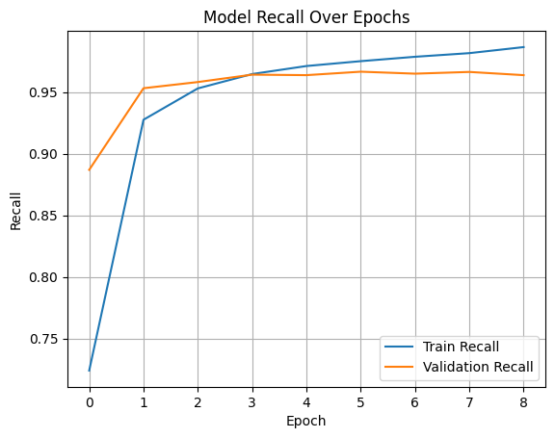
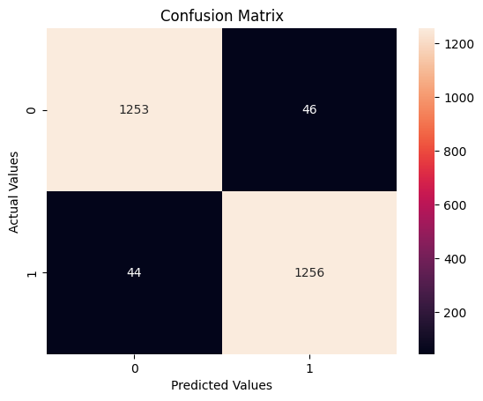
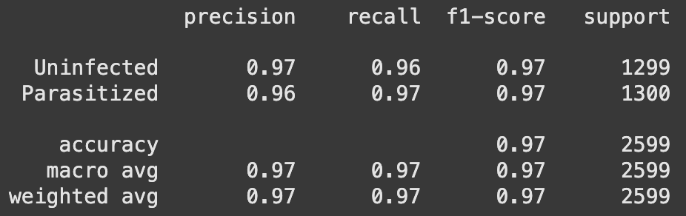
CNN Base Model Results
Fast initial learning
❌Overfitting
✅False Negatives: 44
✅Recall: 97%.
Model Recall over Epochs
Confusion Matrix
1253
46
Metrics
44
1256

Slide 9
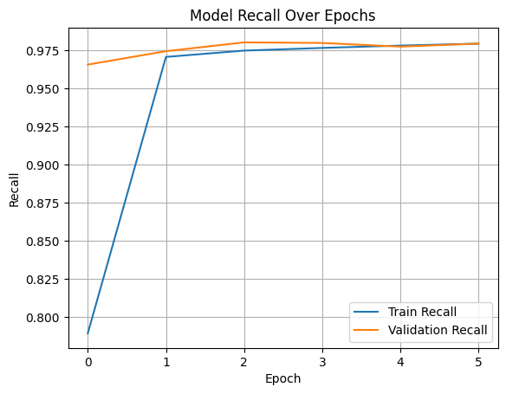

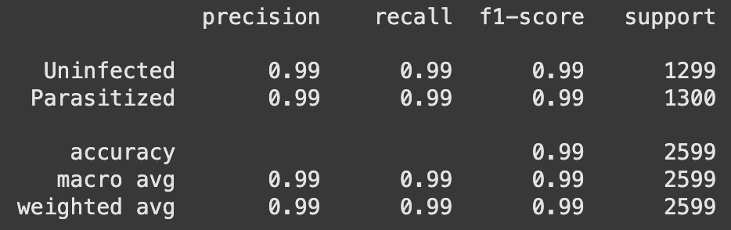
CNN Model Iteration 1 Results
Fast initial learning and matches well after 3 epochs
✅False Negatives: 14
✅Recall: 99%
✅Balanced classifier — it’s not favoring one class over another
✅Great for medical imaging use cases, where recall (sensitivity) is critical
Model Recall over Epochs
Confusion Matrix
1283
16
Metrics
14
1286

Slide 10
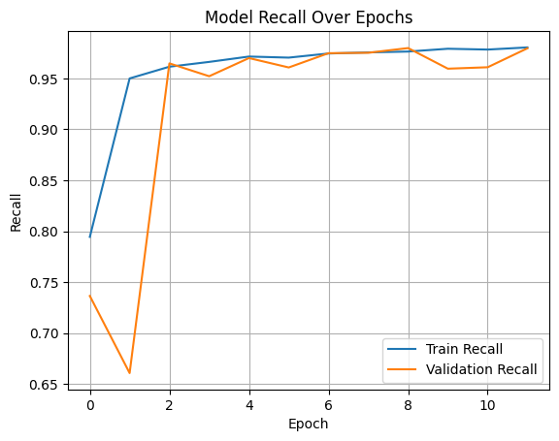

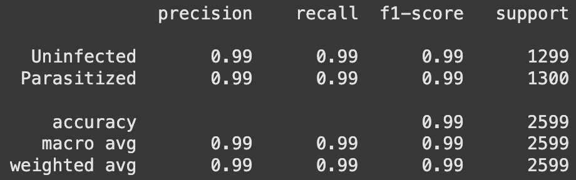
CNN Models Iteration 2 Results
✅False Negatives: 18
✅Recall: 99%
The only difference with Iteration 1 is the batch normalization!
Model Recall over Epochs
Confusion Matrix
1282
17
Metrics
18
1282

Slide 11
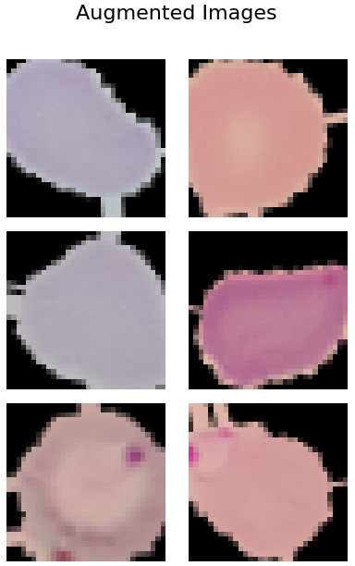
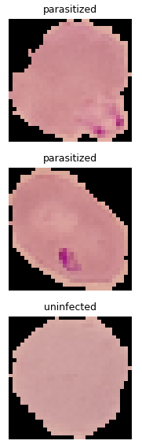
Data Augmentation
Original Images
Augmented Images
Strengthens input images
Increases data set size
Parameters:
rescale=1./255,
rotation_range=15,
width_shift_range=0.1,
height_shift_range=0.1,
shear_range=0.1,
zoom_range=0.1,
horizontal_flip=True,
fill_mode='nearest'

Slide 12
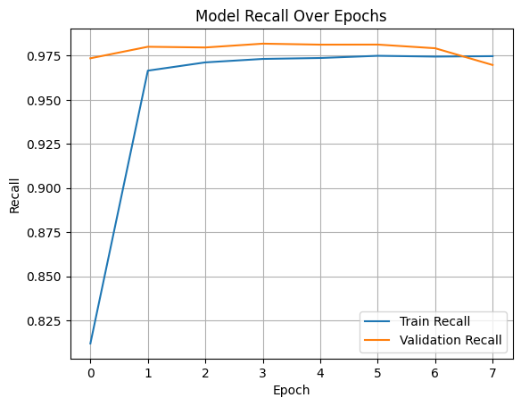


Fitting with Augmented Data
CNN Model - Iteration 1 is used with the augmented data.
✅Recall remains 99%
✅False Negatives: 11
❌Additional preprocessing steps
❌Longer training time
Model Recall over Epochs
Confusion Matrix
1282
17
Metrics
11
1289

Slide 13
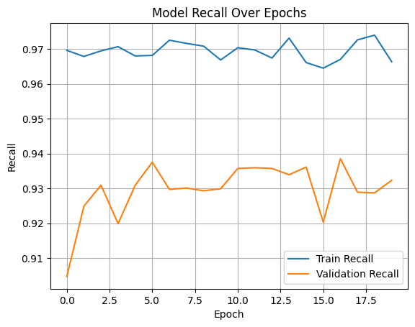
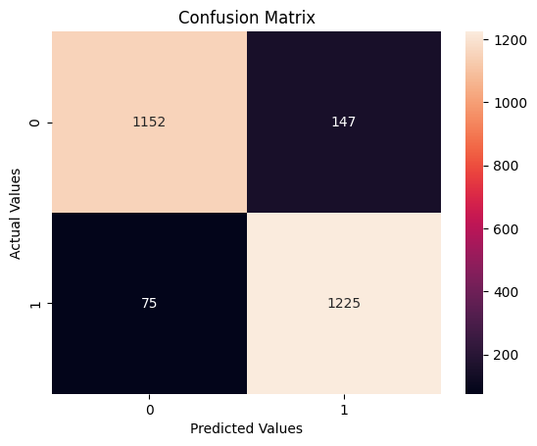
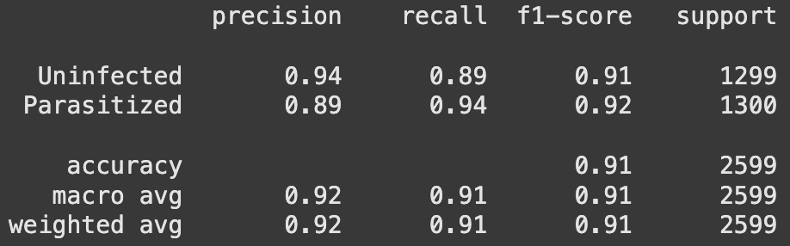
Pretrained model (VGG16)
❌Overfitting
❌False negatives are 75
❌Recall is 94%
❌Longer training time
Model Recall over Epochs
Confusion Matrix
1152
147
Metrics
75
1225

Slide 14
Overall Comparison/Key Takeaways
Best model is CNN Model - Iteration 1 with augmented images:
Model name | Preprocessing steps | Training time | Recall | False Negatives
ANN | ✅ | ✅ | 65% ❌ | 512 ❌
CNN - base | ✅ | ✅ | 97% ❌ | 44 ❌
CNN - 1 | ✅ | ✅ | 99% ✅ | 14
CNN - 2 | ✅ | ✅ | 99% ✅ | 18
Augmented images | ❌ | ❌ | 99% ✅ | 11✅
Pretrained | ❌ | ❌ | 94% ❌ | 75 ❌

Slide 15
Recommendations and Next steps
The model is at 99% recall, however it still missed classify correctly 11 sick cells out of 2.5k.
  Hyperparameter Tuning
  Model Architecture Enhancements
  Regularization and Normalization Techniques
  Training Procedures & Callbacks
The blood cell check is advised to be supported with blood count, antigen tests or other supporting tests

Slide 16
APPENDIX

Slide 17
Model Building
All models are run with:
Output layer: with activation softmax
Compiling: Adam optimizer, categorical cross entropy
Metrics: accuracy, precision, recall
Fit with a validation split of 0.2, batch size = 32,
verbose =1, and epochs = 20, (with callbacks)

Slide 18
Recommendations and Next steps
The model is at 99% recall, however it still missed classify correctly 14 sick cells out of 2.5k.
  Hyperparameter Tuning
    Learning Rate & Optimizer Adjustments
    Batch Size:
  Model Architecture Enhancements
    Increase Depth or Capacity
    Dense Layers
  Regularization and Normalization Techniques
    Dropout Tuning:
  Training Procedures & Callbacks
    Extend Training Epochs
    Learning Rate Scheduling
The blood cell check is advised to be supported with blood count, antigen tests or other supporting tests

